Slide 1
Valuation of Shares: Dividend Discount Model
Dr. Sarveshwar Kumar Inani
sarveshwarinani@wilp.bits-pilani.ac.in

Slide 2
Agenda
Explain the fundamental characteristics of ordinary shares and preference shares.
Show the use of the present value concepts in the valuation of shares.
Valuation Preference Shares (Like bonds valuation)
Valuation of Equity Shares
Source: The content in this ppt is borrowed from the book “Corporate Valuation” by Prasanna Chandra (Mc Graw Hill) and the Book “Financial Management” by I. M. Pandey (Vikas).

Slide 3
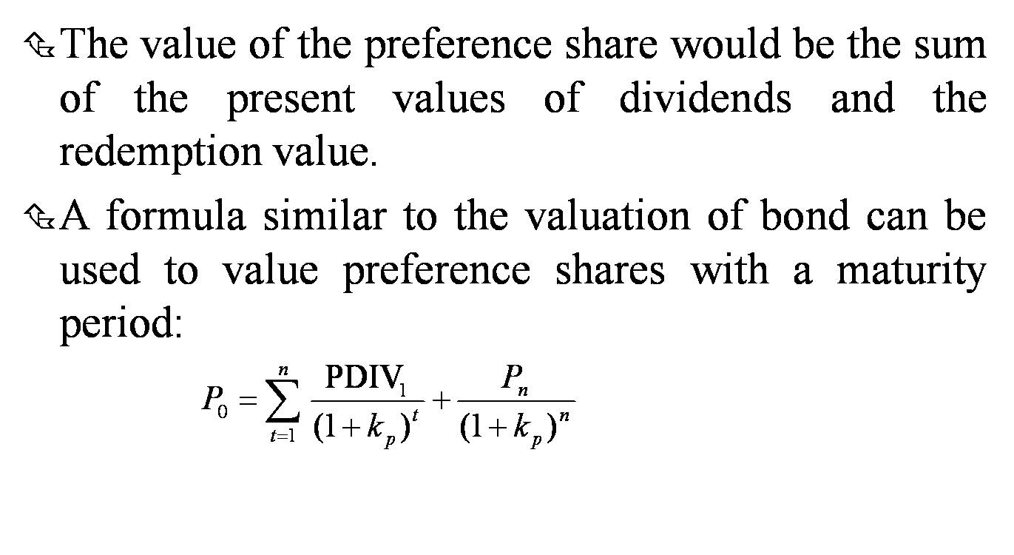
Valuation of Preference Shares (Same process as bonds)

Slide 4
Valuation of Preference Shares (Same process as bonds)
Practice (Explain on excel):
You intend to purchase a 15-year, $1,000-par-value preference shares that has a dividend rate of 9%.If your required return is 10%, what is the value of this preference share? (PV of dividends 684.54+PV of Maturity value 239.39= Total 923.93)

Slide 5
Valuation of Ordinary Shares
The valuation of ordinary or equity shares is relatively more difficult.
The rate of dividend on equity shares is not known; also, the payment of equity dividend is discretionary.
The earnings and dividends on equity shares are generally expected to grow, unlike the interest on bonds and preference dividend.

Slide 6
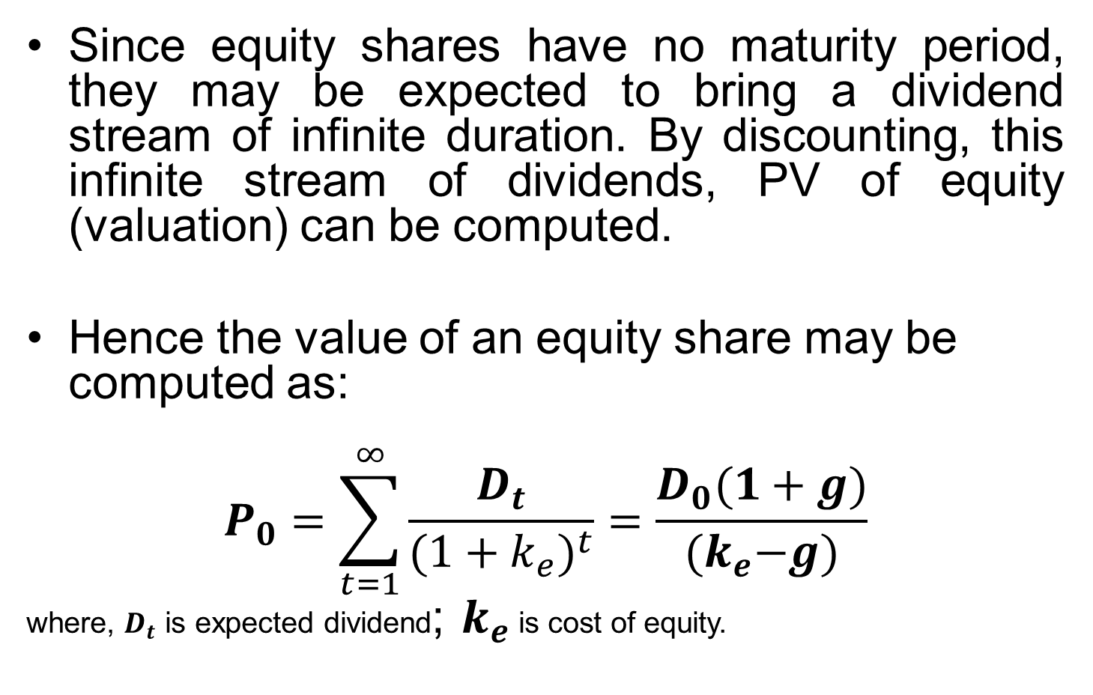
Dividend Discount Model
Since equity shares have no maturity period, they may be expected to bring a dividend stream of infinite duration. By discounting, this infinite stream of dividends, PV of equity (valuation) can be computed.
Hence the value of an equity share may be computed as:
$$P_{0}=\sum_{t=1}^{∞}{\frac{D_{t}}{{(1+k_{e})}^{t}}=\frac{D_{0}(1+g)}{{(k}_{e}−g)}}$$
where, $D_{t}$ is expected dividend; $k_{e}$ is cost of equity.

Slide 7
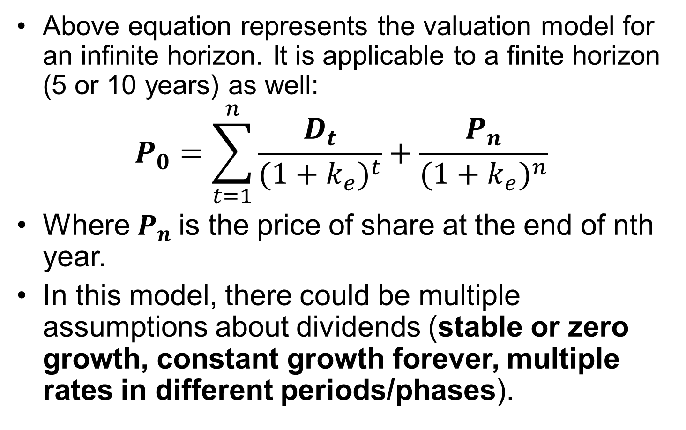
Dividend Discount Model
Above equation represents the valuation model for an infinite horizon. It is applicable to a finite horizon (5 or 10 years) as well:
$$P_{0}=\sum_{t=1}^{n}{\frac{D_{t}}{{(1+k_{e})}^{t}}+\frac{P_{n}}{{(1+k_{e})}^{n}}}$$
Where $P_{n}$is the price of share at the end of nth year.
In this model, there could be multiple assumptions about dividends (stable or zero growth, constant growth forever, multiple rates in different periods/phases).

Slide 8
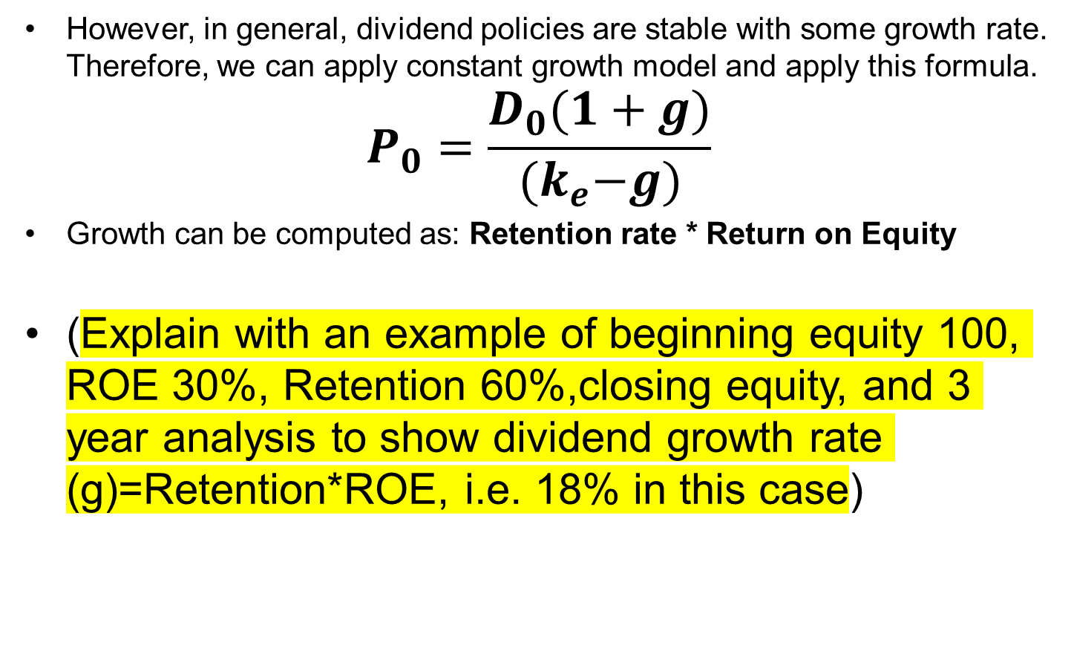
Dividend Discount Model
However, in general, dividend policies are stable with some growth rate. Therefore, we can apply constant growth model and apply this formula.
$$P_{0}=\frac{D_{0}(1+g)}{{(k}_{e}−g)}$$
Growth can be computed as: Retention rate * Return on Equity
(Explain with an example of beginning equity 100, ROE 30%, Retention 60%,closing equity, and 3 year analysis to show dividend growth rate (g)=Retention*ROE, i.e. 18% in this case)

Slide 9
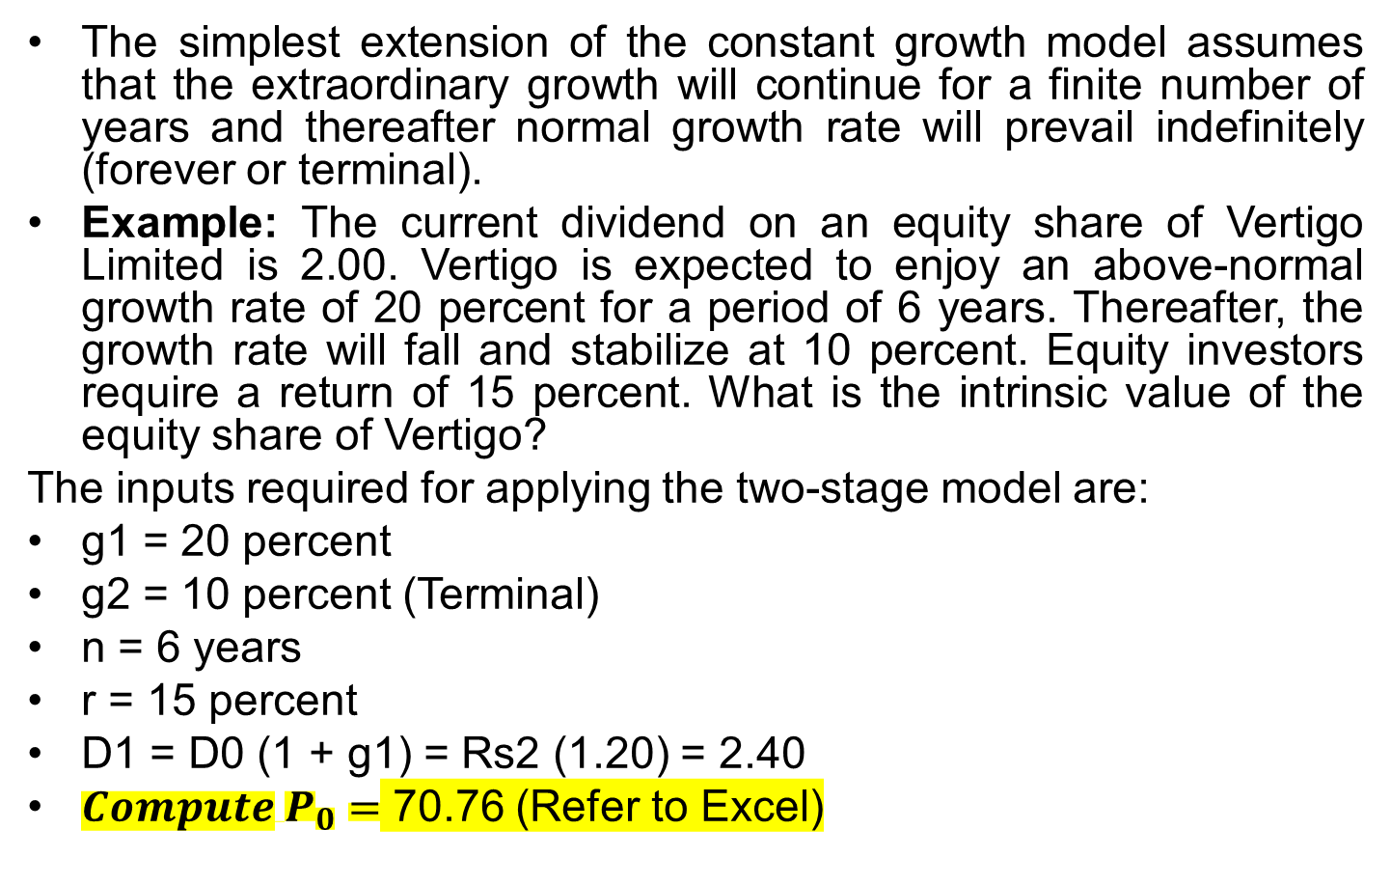
Dividend Discount Model: Two stage growth model
The simplest extension of the constant growth model assumes that the extraordinary growth will continue for a finite number of years and thereafter normal growth rate will prevail indefinitely (forever or terminal).
Example: The current dividend on an equity share of Vertigo Limited is 2.00. Vertigo is expected to enjoy an above-normal growth rate of 20 percent for a period of 6 years. Thereafter, the growth rate will fall and stabilize at 10 percent. Equity investors require a return of 15 percent. What is the intrinsic value of the equity share of Vertigo?
The inputs required for applying the two-stage model are:
g1 = 20 percent
g2 = 10 percent (Terminal)
n = 6 years
r = 15 percent
D1 = D0 (1 + g1) = Rs2 (1.20) = 2.40
${Compute P}_{0}=$ 70.76 (Refer to Excel)

Slide 10
Dividend Discount Model: Three stage growth model
It assumes an initial period of stable high growth, a second period of linearly declining growth period, and a third period of stable low growth, that extends forever.
Example: The current earnings per share (EPS) of Gamma Limited is 5.00. For the next five years, the earnings per share is expected to grow at 20 percent and the dividend payout ratio in the high growth period will be 20 percent. The growth rate in earnings per share will decline linearly for the following five years to 10 percent per year (i.e. decline of 2% point each year). During this period, the dividend payout ratio will increase linearly from 20 percent to 60 percent (i.e. decline of 8% point each year). After the tenth year, the growth rate in earnings per share will remain stable at 10 percent for ever. During the stable growth rate period, the payout ratio will be 60 percent. During the high growth period, the cost of equity will be 18 percent; during the transition period, the cost of equity will fall by 0.8 percent per year; finally, during the stable growth period, the cost of equity will be 14 percent. What is the intrinsic value per share as per the three-stage dividend discount model? (Refer to Excel)

Slide 11
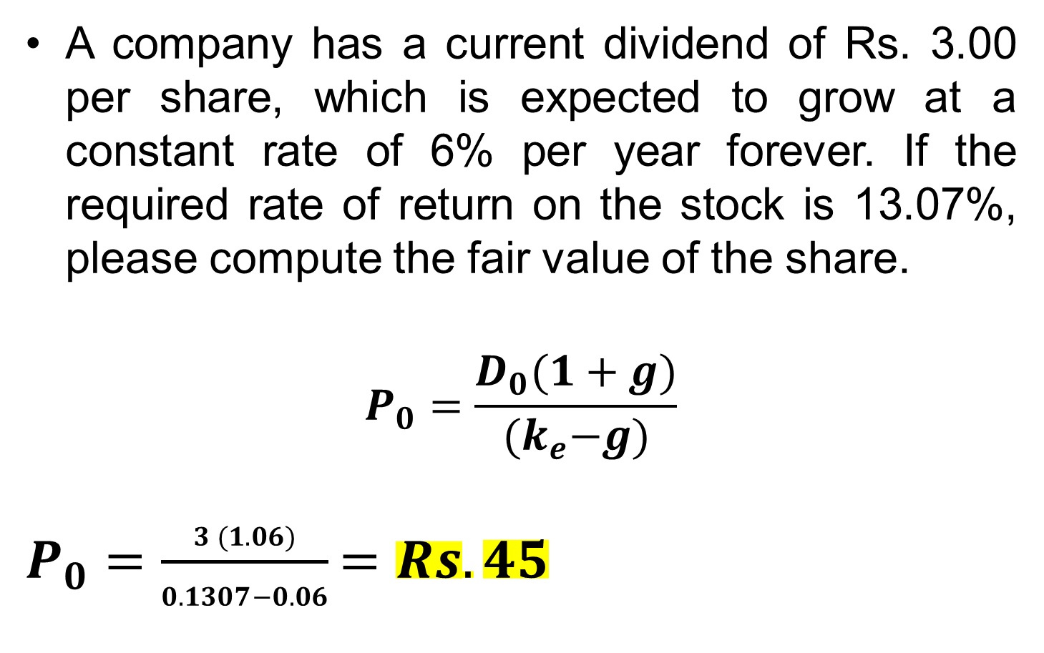
DDM: Perpetual constant growth model
A company has a current dividend of Rs. 3.00 per share, which is expected to grow at a constant rate of 6% per year forever. If the required rate of return on the stock is 13.07%, please compute the fair value of the share.
$$P_{0}=\frac{D_{0}(1+g)}{{(k}_{e}−g)}$$
$P_{0}=\frac{3 (1.06)}{0.1307−0.06}=Rs. 45$

Slide 12
DDM: Pros and Cons
Pros:
It is simple and intuitively appealing. After all, dividends are the only cash flows that the shareholders receive from the firm.
Fewer assumptions are required to forecast dividends than to forecast free cash flows. Dividend forecast can be obtained by applying growth rate estimate to dividend paid last year. Free cash flow forecast requires assumptions about net operating profit after tax, capital expenditure, depreciation, and working capital.
Dividends (generally stable than earnings and cashflows) and growth can be computed easily.
Cons:
It is unrealistic that a dividend growth rate will increase at a constant rate forever.
Not applicable for non-dividend paying companies.

Slide 13
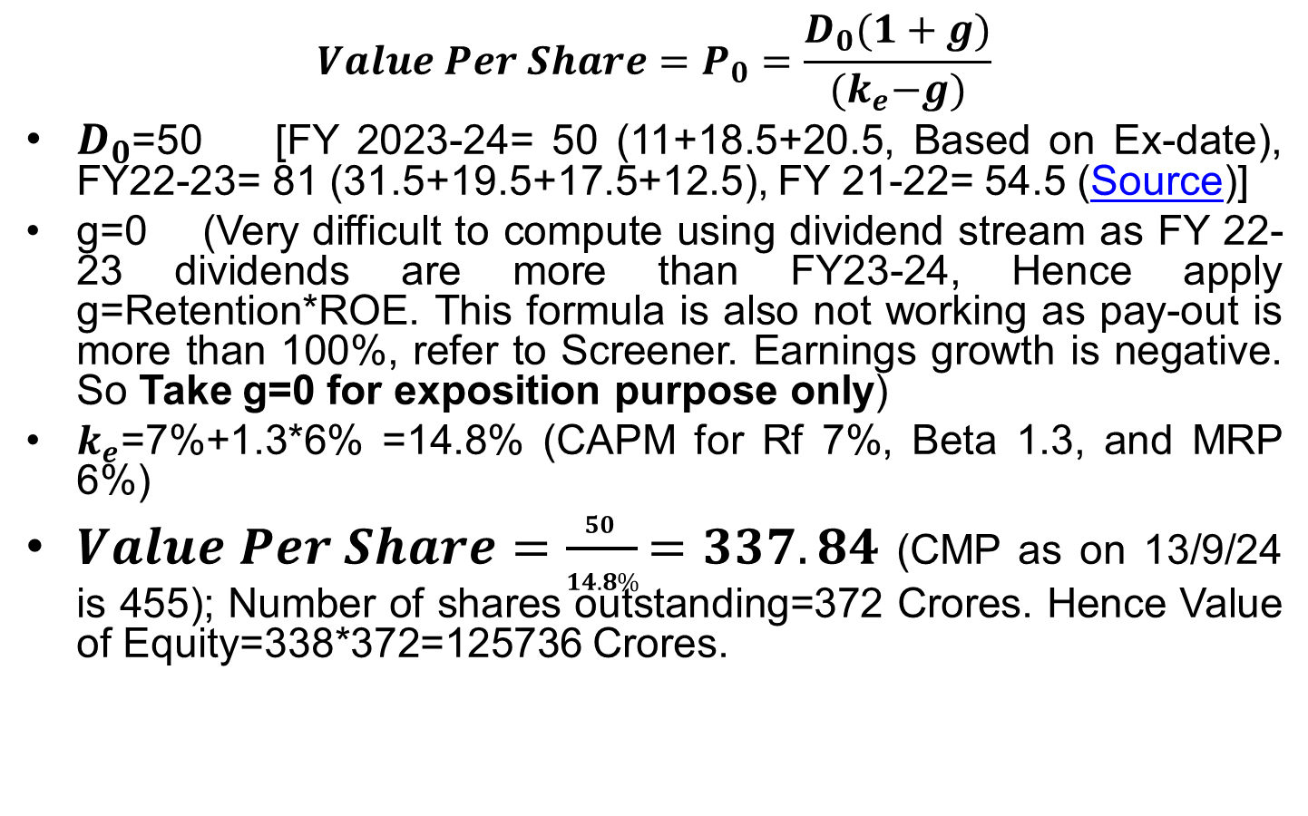
Complex Example: Valuation of Vedanta Ltd.
$$Value Per Share=P_{0}=\frac{D_{0}(1+g)}{{(k}_{e}−g)}$$
$D_{0}$=50 [FY 2023-24= 50 (11+18.5+20.5, Based on Ex-date), FY22-23= 81 (31.5+19.5+17.5+12.5), FY 21-22= 54.5 (Source)]
g=0 (Very difficult to compute using dividend stream as FY 22-23 dividends are more than FY23-24, Hence apply g=Retention*ROE. This formula is also not working as pay-out is more than 100%, refer to Screener. Earnings growth is negative. So Take g=0 for exposition purpose only)
$k_{e}$=7%+1.3*6% =14.8% (CAPM for Rf 7%, Beta 1.3, and MRP 6%)
$Value Per Share=\frac{50 }{14.8\%}=337.84$ (CMP as on 13/9/24 is 455); Number of shares outstanding=372 Crores. Hence Value of Equity=338*372=125736 Crores.

Slide 14
THANK YOU!!!

